Slide 1
The vacuum chest wall lifter: an innovative, nonsurgical addition to the management of pectus excavatum
Felix Schier*, Michael Bahr, Eckard Klobe
Journal of Pediatric Surgery (2005) 40, 496 – 500

Slide 2
Introduction
In many cases of pectus excavatum, the degree of pectus deformity does not immediately warrant surgery, yet patients require some type of nonsurgical treatment.
Other patients are reluctant to undergo surgery because of the pain associated with postoperative recovery and the risk of imperfect results. The success of the Nuss procedure demonstrates that many patients would welcome a less invasive technique.
The procedure of applying a vacuum to correct the malformed chest wall was first used more than 100 years ago [1,2]. Although there has been little progress in the therapeutic use of vacuum procedures since, the materials have improved.
Vacuum devices can exert strong forces, as demonstrated by their many industrial applications.
A vacuum cup may also be useful in the Nuss procedure, where the riskiest step of the procedure is the advancement of the introducer between the heart and sternum. With use of a vacuum cup, the sternum can be pulled forward within minutes, reducing the risk of injury to the heart.
In addition, using the suction cup for a few months preoperatively might improve the results of eventual surgery. In this paper, we report our results using such a device in patients with pectus excavatum.

Slide 3
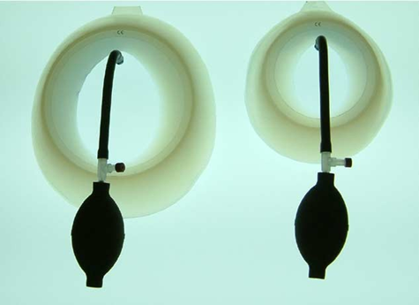
Fig. 1 Two different sizes of the suction cup.

Slide 4
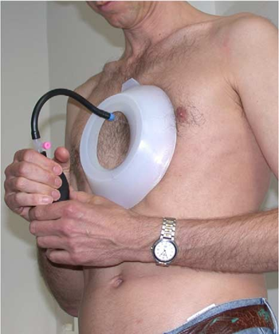
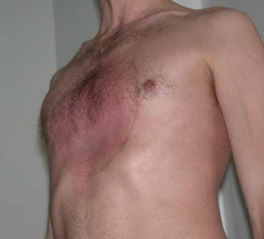
1. Materials and methods
Vacuum was created by a suction cup activated by the patient with a hand pump up to 15% below atmospheric pressure (Figs. 1-3). Progress was documented by photo- graphy, radiography, and plaster casts of the defect.
Fig. 2 Adult patient using the hand pump.
Fig. 3 After 2 hours of suction cup use.

Slide 5

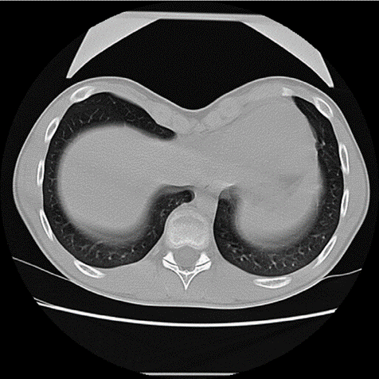
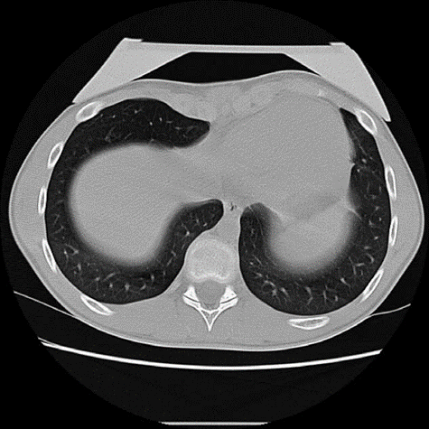
The suction cup’s effect on the anatomy of chest wall, heart, great vessels, and diaphragm was studied before routine use in 2 patients (14- and 15-year-old boys) under- going computed tomographic (CT) scans. Surprisingly, the sternum lifted markedly within 2 minutes despite the rela- tively advanced age of the patients. The sternum sank back after the negative pressure was neutralized (Figs. 4 and 5).
Fig. 4 Computed tomography before vacuum
Fig. 5 Computed tomography after 2 minutes of vacuum.

Slide 6
- Subsequently, 60 patients (56 males, 4 females) were treated with the suction cup within 18 months; 57 patients had symmetrical and 3 had asymmetrical pectus excavatum.
- In the 3 patients with asymmetrical pectus excavatum, the suction cup was applied horizontally in contrast to the usual vertical position.
- Surgical therapy had been previously suggested for 35 of the patients; 7 were referred to our department, and the other 18 had been referred to surgeons in other institutions. These patients had learned by chance of the suction cup procedure through the Internet only after being referred for surgery.
- The patients ranged in age from 6.1 to 34.9 years (median, 14.8 years). Because the cups are more difficult to adapt to the female thoracic shape, the patients were predominantly male, and only 4 female patients were included (aged 13-15 years).

Slide 7
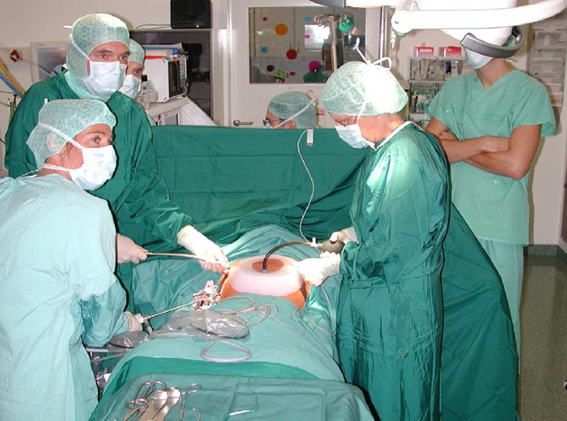
- Daily application of the suction cup varied between individuals, at the discretion of the patient. Application ranged from 30 minutes twice per day up to 5 hours daily, with a median duration of 1.5 hours.
- In addition to the patients described above, in 14 children the suction cup was used during the Nuss procedure to enlarge the retrosternal space for safer passage of the introducer (Fig. 6).
Fig. 6 Using the vacuum cup during the Nuss procedure

Slide 8
2. Results
The skin underneath the cup remained uninjured, although all patients developed moderate local subcutane- ous hematoma, which subsided after a few hours. There was no permanent skin discoloration or discomfort.
During initial treatment, all patients experienced moderate pain in the sternum, and 50% of patients reported pain at the costovertebral joints.
One patient suffered from transient paresthesis in the right arm and leg.
The pain was very moderate, not requiring analgesic medication in any patient.
Two patients experienced orthostatic disturbances during the first application of the suction cup, but this did not recur in subsequent procedures.
There were no other complications observed in these patients.

Slide 9

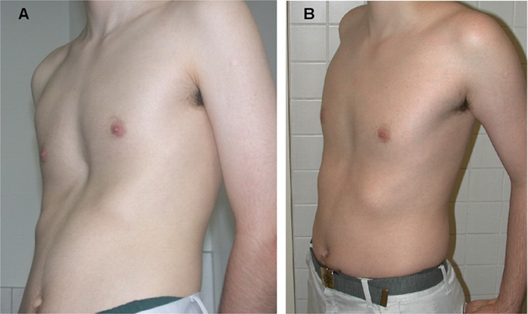
In CT scans, the device lifted the sternum and the ribs within 2 minutes. Initially, the sternum sank back after few minutes. This was confirmed by intraoperative thoracoscopy, which clearly showed the elevation of the sternum away from the heart, followed by an immediate return to its original position after release of the negative pressure.
The procedure was also applied nonsurgically. After 1 month, we noted marked improvement in body posture and an elevation of the sternum depression by 1 cm in all patients (Fig. 7).
Fig. 7 Nonsurgical use before (A) and after (B) 2 months

Slide 10
After 5 months, the sternum had been elevated to the normal level in 12 patients evaluated immediately after application of the suction cup.
Patient follow-up occurred from 2 to 18 months (median, 10 months) after first using the procedure.
One patient has finished therapy after 9 months with good results.
At follow-up, all patients were highly satisfied and continued to use the cup.
One child requested surgery after a short trial because of discomfort with the cup.

Slide 11
3. Discussion
A vacuum was used as early as 1910 by Lange [1] in Munich for lifting the depressed sternum.
The suction cup used in our study was developed and tested by an engineer who had pectus excavatum (EK, third author); he developed this device as an attempt to avoid surgery.
The only true long-term result obtained so far has been by the engineer himself, who no longer exhibits pectus excavatum. It appears, however, that he has several costosternal pseudarthroses, possibly because he caused minor fractures while experimenting with a wide range of negative pressures and different suction cup models.

Slide 12

- The suction cup is now used by an increasing number of patients, mostly suffering from pectus excavatum not serious enough to warrant surgery, yet sufficiently marked to induce psychological complications. Other patients had previously consented to surgery, but preferred to try a nonsurgical method first.
- All patients except 1 were satisfied with the suction cup procedure, although objective improvement, as shown by photographs and plaster casts, was minimal in most cases.
The maximal lift achieved was 1 cm per month. All patients improved body posture while using the suction cup. This seems to be the main affect of the suction cup. It is possible that the patients’ perceptions and awareness of body shape were altered by the procedure, which also involved regular office visits, discussions, and regular photographs.
In addition, the device is experimental and is not reimbursed by health insurers, possibly providing the patients a feel of being bpioneersQ in its use. At present, the long-term effects of this procedure are unclear.

Slide 13
- Children up to the age of 10 years find the application of the suction cup more difficult than older children or adolescents. Even the moderate vacuum used in the cup is able to exert strong forces. We would hesitate to apply these forces in the soft chest of young children not knowing exactly how the big vessels’ configuration is influenced by vacuum. The force is, as demonstrated in the CT, strong enough to deform the far more rigid chest within minutes. The patients we found most interested in the suction cup were adolescents.

Slide 14
We propose that the suction cup offers 4 different applications:
+ It may allow some patients with pectus excavatum to avoid surgery altogether, although the follow- up of the patients in the current study was too short to determine this with any certainty. The total duration of suction cup treatment needed to induce a permanent change may be similar to the orthodontic correction of teeth; that is, it may require an initial 2 years followed by an extended maintenance period of several years, which may include a risk of reverting to the initial shape. Therefore, at present, it is unknown how long the device has be used by an individual patient to achieve optimal results.
+ Second, the suction procedure may be useful in preparation for surgery. Some surgeons request patients to undergo a scheme of respiratory and physical therapy for several months before surgery, with the idea of loosening connective tissue and thus facilitating subsequent repair via open or less invasive techniques.
+ Third, the suction cup may be helpful if a bar has to be removed earlier than scheduled, such as in an infection or because of pain. The suction cup may then help stabilize, maintain, or even improve the surgical result.
+ Finally, we have used the suction cup intraoperatively to lift the sternum up from the heart during the Nuss procedure.

Slide 15
- Overall acceptance by the patients and their parents was excellent.
In patients with pectus excavatum, application of a vacuum effectively pulls the depressed anterior chest wall forward. The initial results proved dramatic, although the time required for long-term correction is unknown.
This method holds promise as a valuable adjunct therapy in the correction of pectus excavatum.

